Slide 1

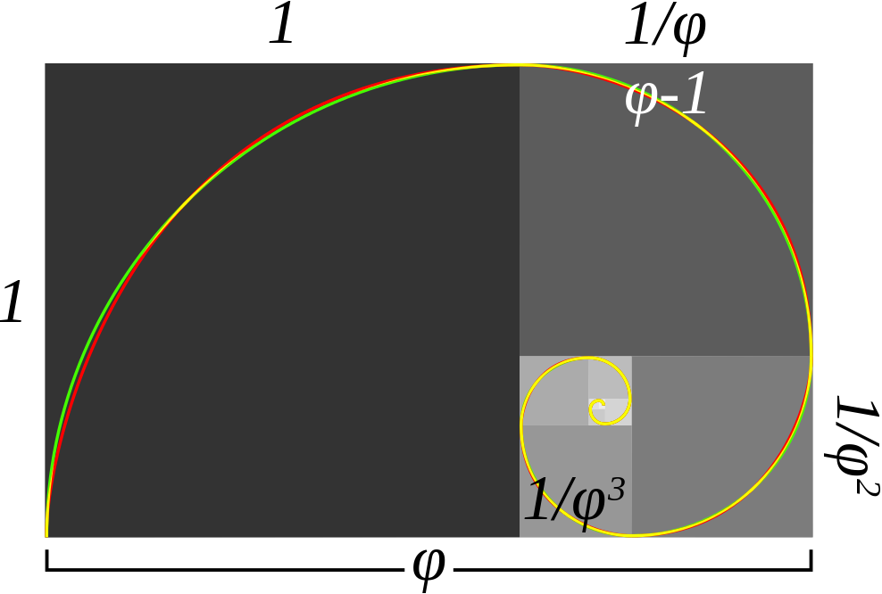
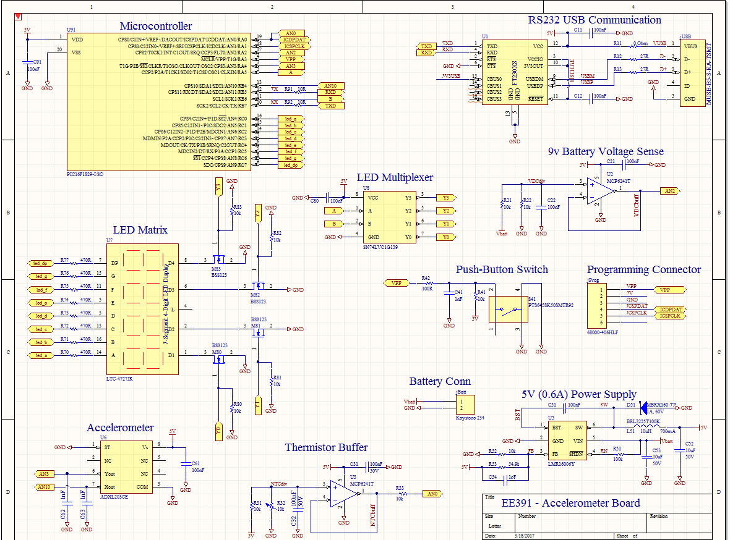


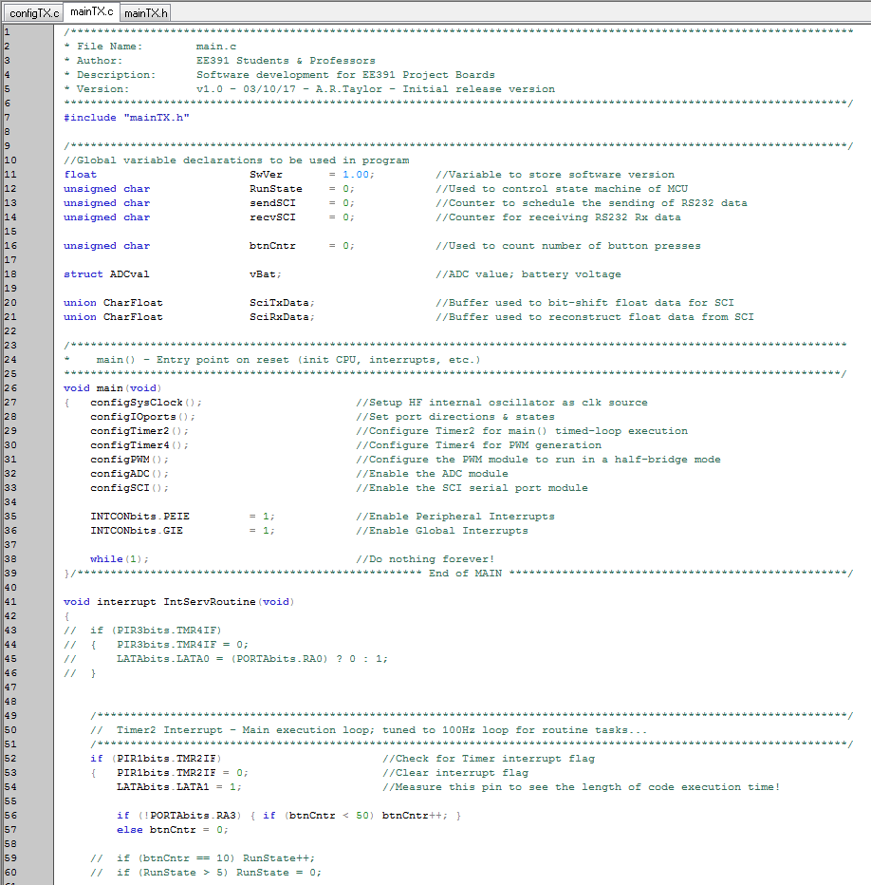

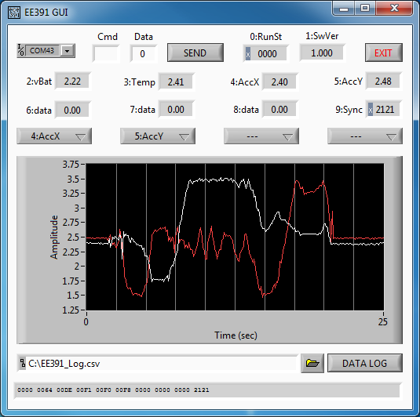
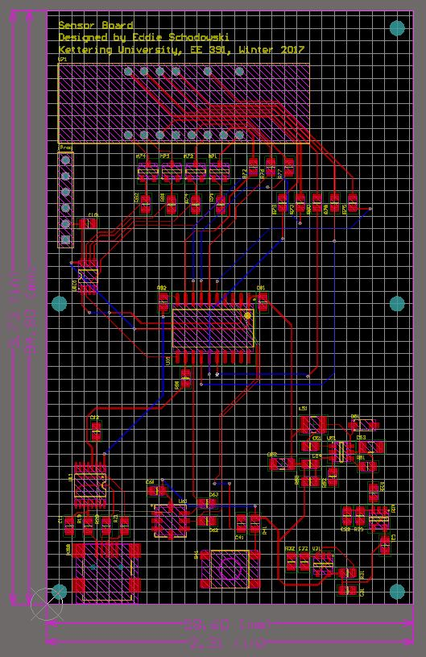
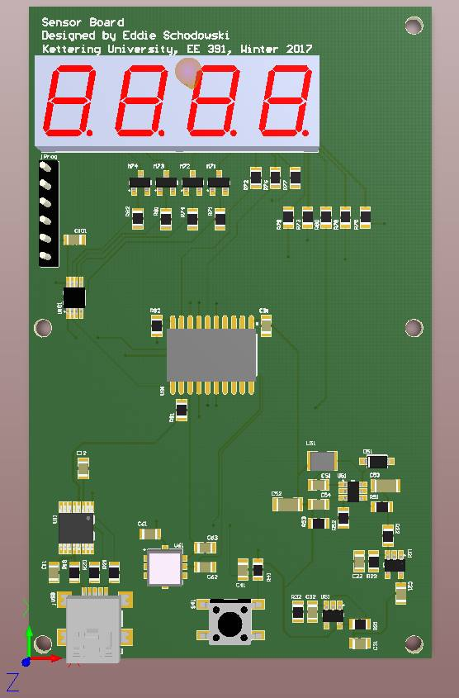
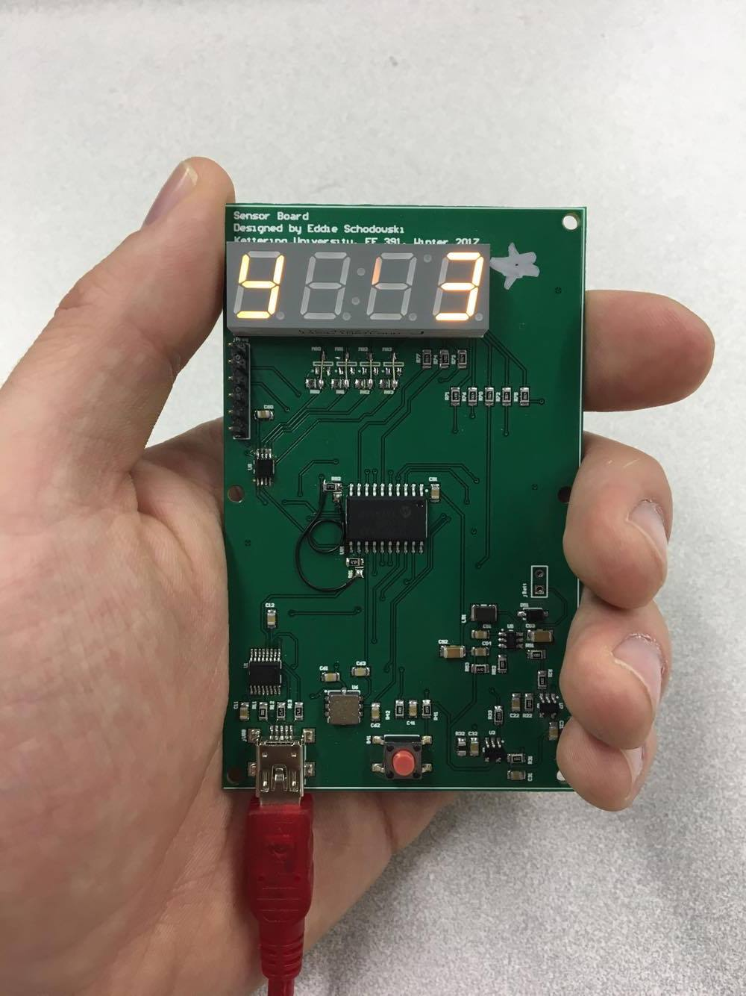





Sensor Board
Eddie Schodowski
EE391 Class Project
EE391: EE Design & Testing
Term Poster: March 22nd, 2017
Prof. Taylor, Kettering University
Project Overview
Schematic Design
Inputs:
Accelerometer Data
Thermistor Data
Push Button
Outputs:
7 Segment Display (X, Y, Temp, Programmable Output)
Design Considerations:
7 Segment Display at Top for Readability
iPhone 5S Width
Length = (Golden Ratio = 1.618) * Width
Tactile Switch located in iPhone home button position
USB on bottom left corner
Project Interest:
Right size project for 10 week term
Sensors common in consumer hardware (e.g., Fitbit)
Finding problems hardware can economically solve takes a lot of practice building things first (e.g., Square)
Schematic:
Clean schematic documentation is essential for teams
Lessons Learned:
New product development in hardware requires an understanding of systems that are comprised of the fundamental components that you can later fit together like a puzzle at the system level
Most embarrassing schematic mistakes only happen once!
You’ll never
make or forget
those mistakes
again after the
PCB gets built!
☺
Printed Circuit Board Layout
MCU Software / GUI
Routing:
Real engineering design; like a puzzle for electrons! No solutions, only trade-offs.
“Great artists ship.”
Important to storyboard out user experience so hardware fits ergonomically into use case
e.g., button placement, LEDs, etc.
Assembly / Board Population:
Takes practice ☺
Software:
It’s worth deeply understanding C and Micros. Takes time.
GUI:
How can your GUI design teach you something useful about your hardware capabilities in the real world?
Okay, after you’ve built it, how do you test it?
MPLAB Software Environment
LabVIEW Graphical User Interface
PCB 2D Layout
PCB 3D CAD Model
Actual Assembled PCB
Acknowledgements
Special thanks to the KU Builder’s & Innovation network for sponsoring the projects PCB
and component costs.

